Slide 1
Load Frequency Control
Power Frequency Control, Real Power Frequency Control
Automatic Generation Control( freq. deviation=0)

Slide 2
LFC in an interconnected system
The basic role of LFC is:
To maintain the desired megawatt output power of a generator matching with the changing load.
2. To assist in controlling the frequency of larger interconnection.
3. To keep the net interchange power between pool members, at the predetermined values
small and slow changes in load and frequency.

Slide 3
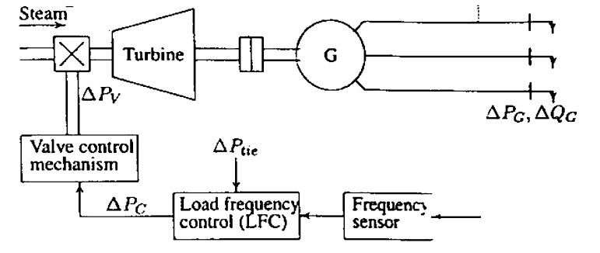
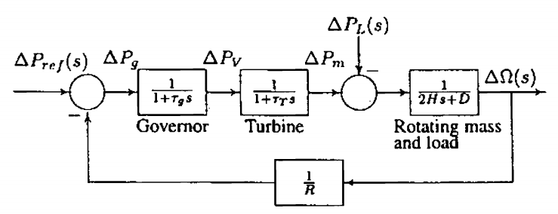
Gen & Load Block

Slide 4
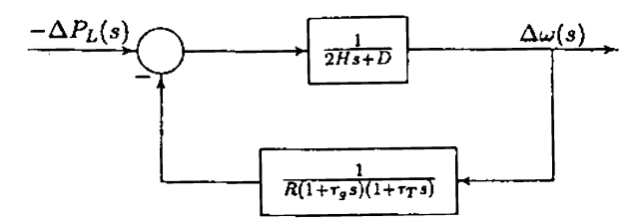
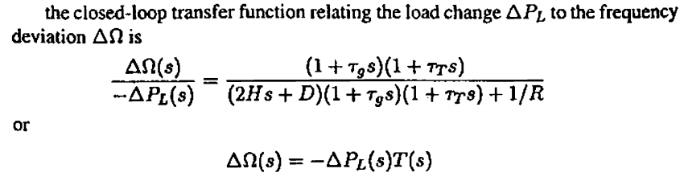
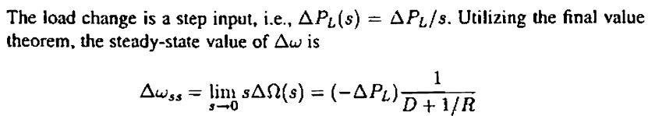


Slide 5
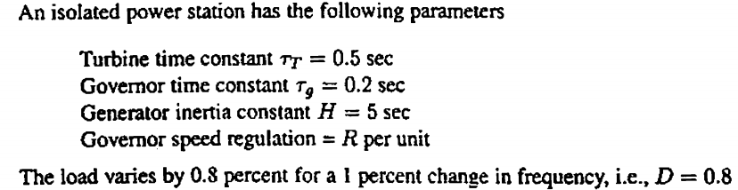

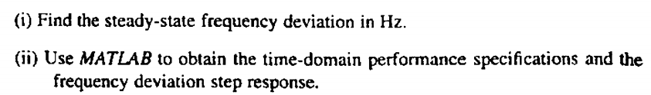

Problem Statement

Slide 6
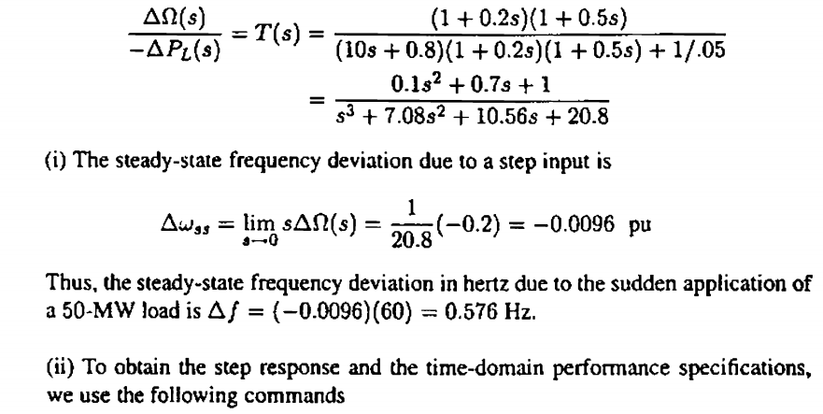

Slide 7
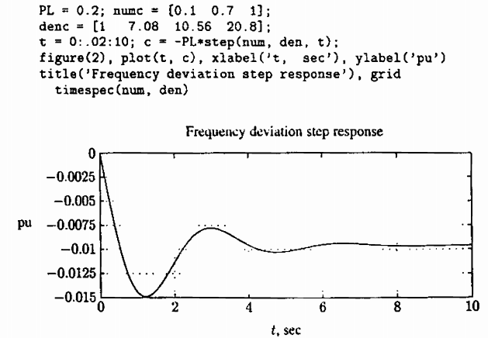

Slide 8
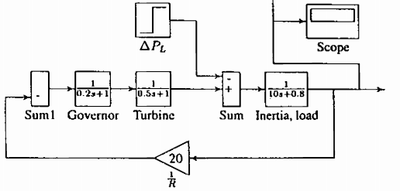

Slide 9
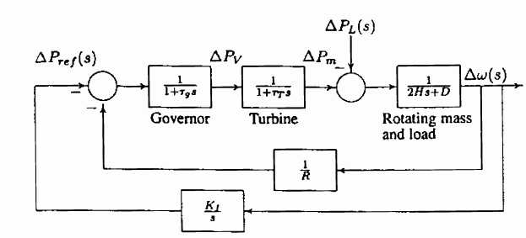
Automatic Generation Control

Slide 10
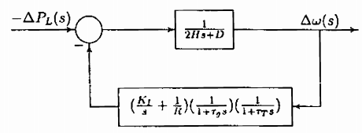


Slide 11
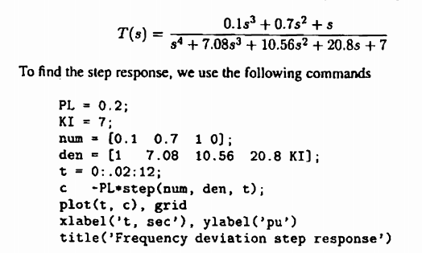
Problem Statement

Slide 12
